Slide 1

MINOR PROJECT - II ON CAMPUS CONNECT (MCA – II SEMESTER; BATCH 2025-27)
Internal Guide
Dr. Sunil Pratap Singh (Asst. Prof., BVICAM, New Delhi)
Presentation by
VARUN RAWAT (03711604425)
SAKSHAM (06311604425)
RUDRANSH SINGH RAWAT (06411604425)
HIRIK ANAND (07111604425)
PIYUSH GOEL (09311604425)
15 May-2026
Notes:
1

Slide 2
Contents
Problem Description
Aim and Objectives
Methodology and Technology Used for Project Development
Project Modules
Design Documents (Use Case, Data Flow Diagram, Entity-Relation Diagram, etc.)
Screenshots
Testing of Project
Conclusion
Future Scope
Bibliography

Slide 3
Problem Description
In most colleges, the current students often find it difficult to reach out to the pass-out seniors for any guidance pertaining to internships, placements, higher studies, mentorship regarding projects, and career paths. The communication happens over very informal channels: WhatsApp groups, personal contacts, or social media, which results in limited reach, authenticity, and communication gaps. Because of this, there isn't any single place where students can easily find verified alumni and reach out to them for interaction or asking questions regarding their careers. Similarly, alumni who are willing to guide juniors do not have a structured way to share their experiences, job updates, or opportunities.

Slide 4
Aim and Objectives
Aim:
To develop a Java based Web application to create a networking bridge between the students and passout students.
Objectives:
To design a relational database for managing Alumni Data.
To design user-friendly interfaces to interact with the system.
To create a Alumni Directory which is easily sortable.
To create a memory wall for alumni named Memory Wall.
To test the developed system.

Slide 5
Methodology and Technology Used
Methodology used for Project Development:
Agile Model was used for this projects development.
Technology used for Project Development:
Language used: Java SE 17, JavaScript (ES2025), HTML5
Tools used: Apache Maven 3.9, Spring Boot 3.3
Integrated Development Environment (IDE): Apache Netbeans 29
Database: MySQL Server (TiDB connection)

Slide 6
Project Modules
Project Modules:
Profile
Alumni Directory
Messages
Jobs
Wall
Events
Global chat

Slide 7
System Design

Slide 8
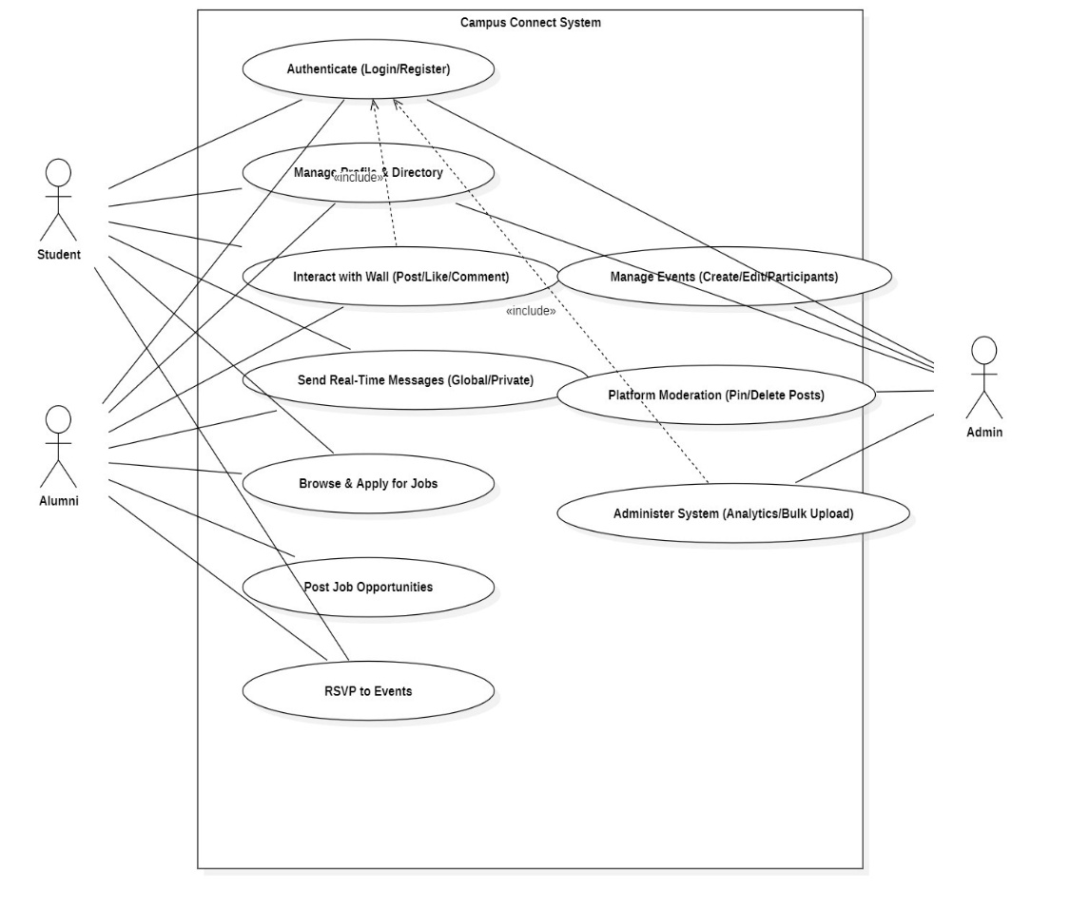
Use Case Diagram

Slide 9
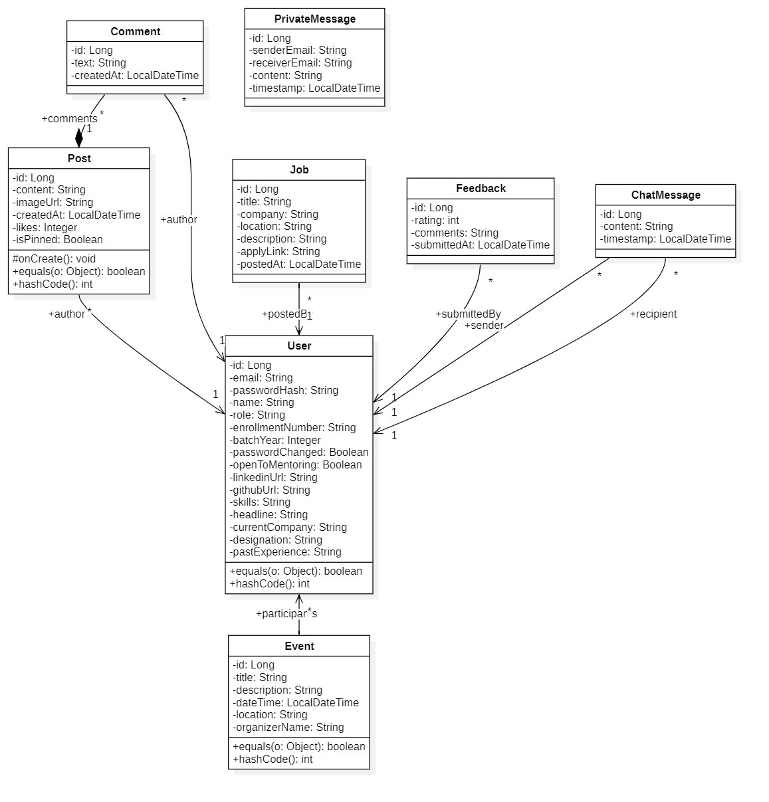
Class Diagram

Slide 10
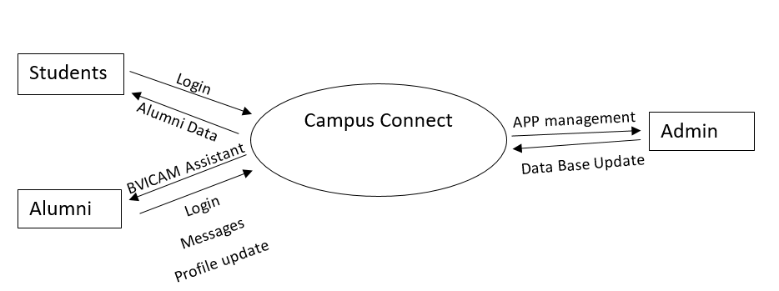
Data Flow Diagram (Level - 0)

Slide 11
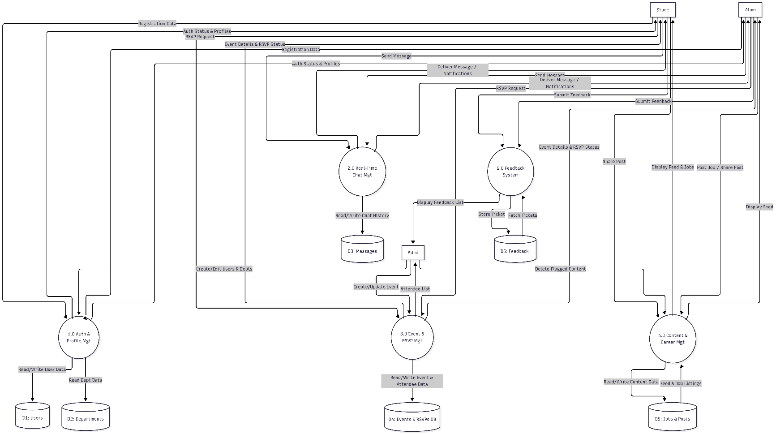
Data Flow Diagram (Level - 1)

Slide 12
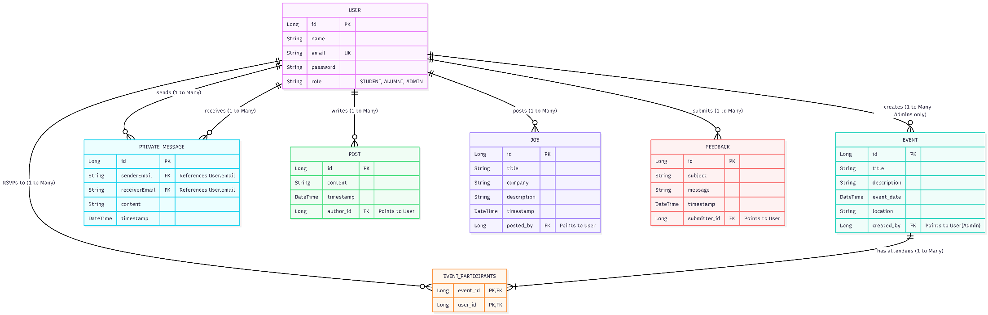
Entity-Relationship (E-R) Diagram

Slide 13
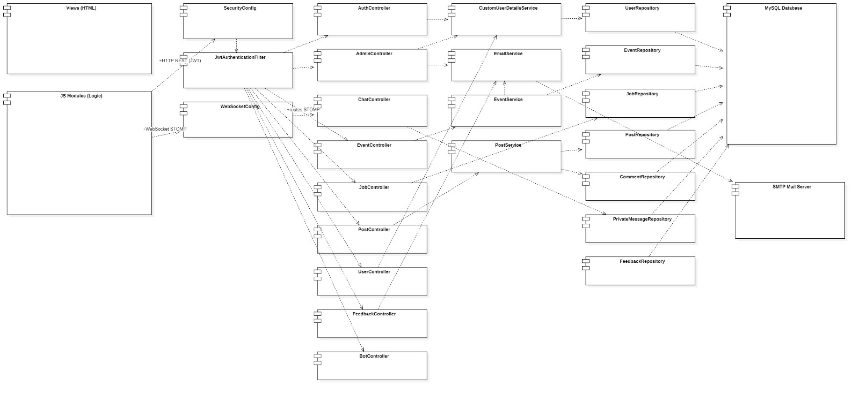
Component Diagram

Slide 14
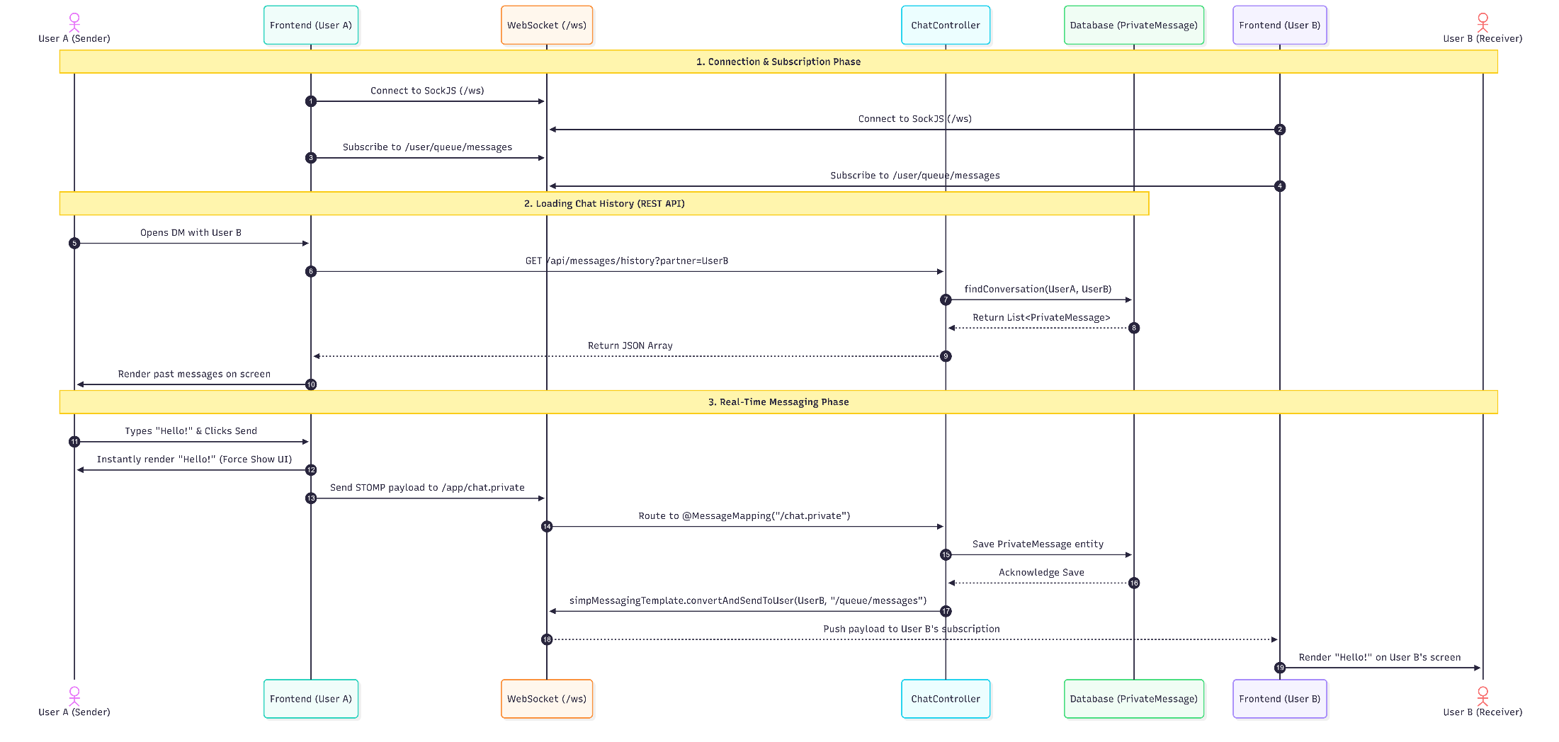
Sequence Diagram

Slide 15
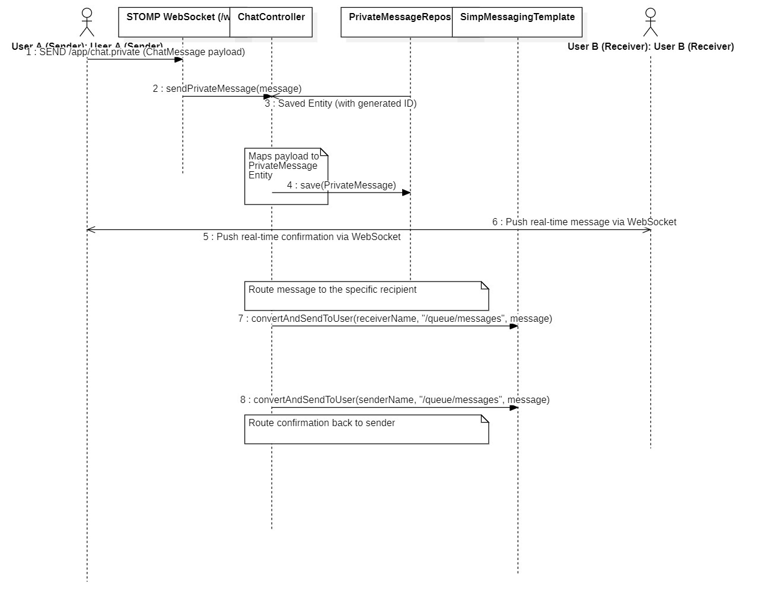
SequenceDiagram(Chat via WebSocket)

Slide 16
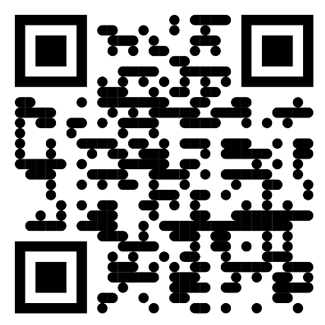
Screenshots

Slide 17
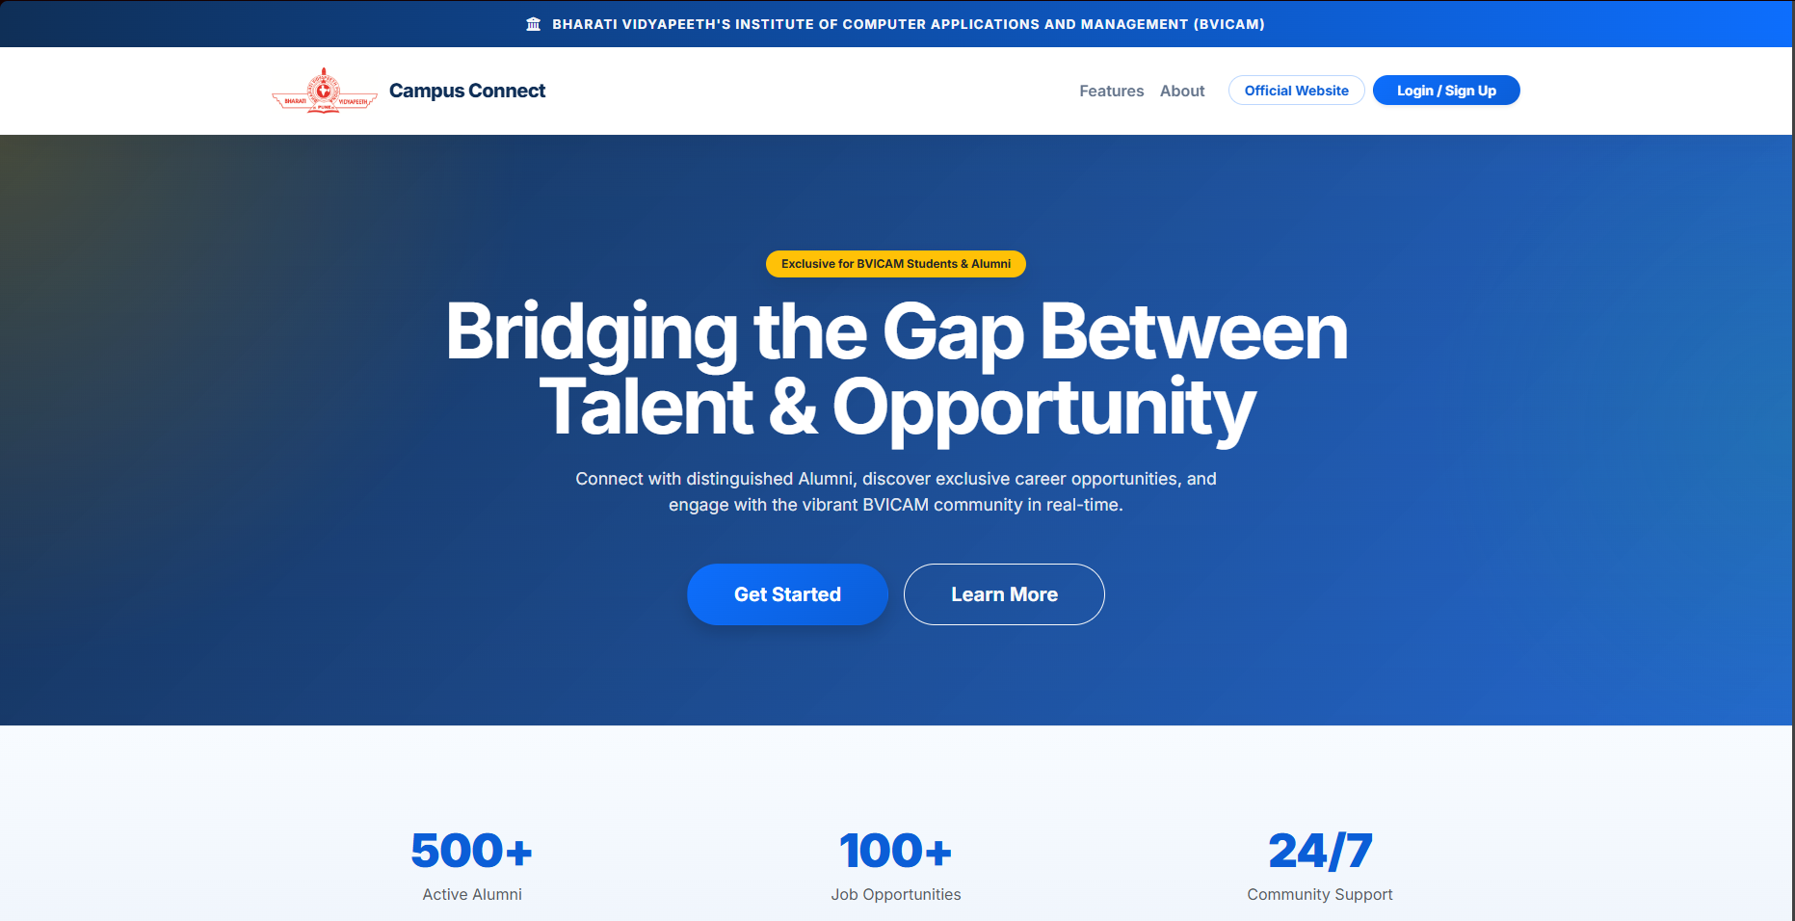
Screenshot - 1: Dashboard

Slide 18
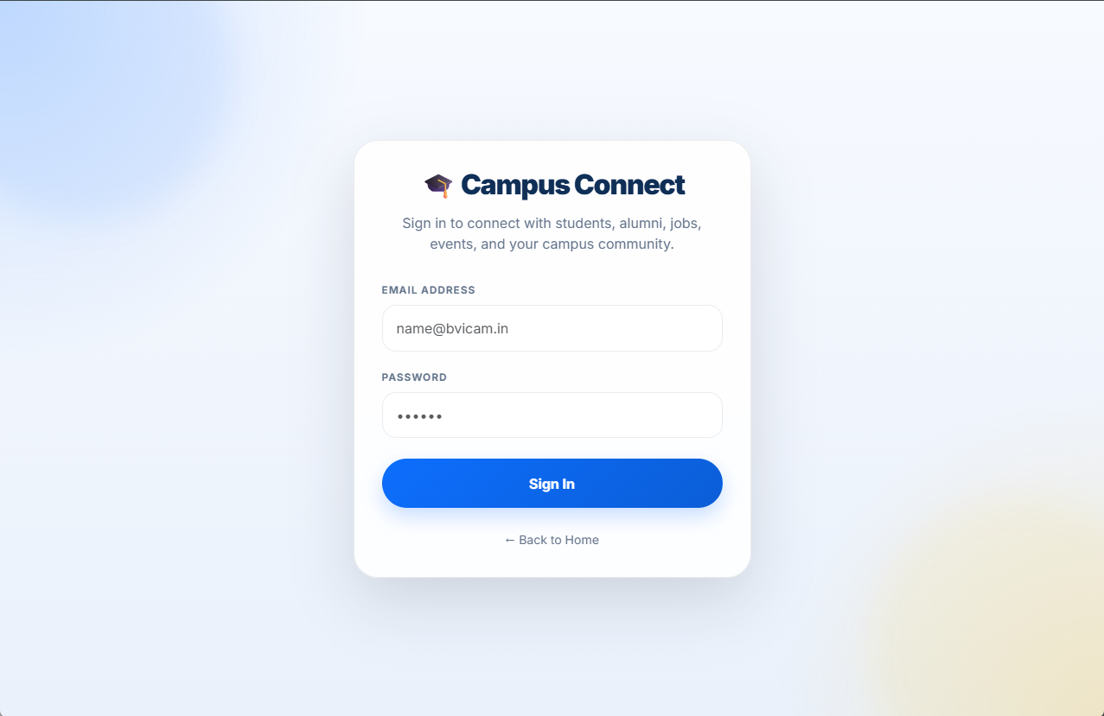
Screenshot - 2: Login

Slide 19
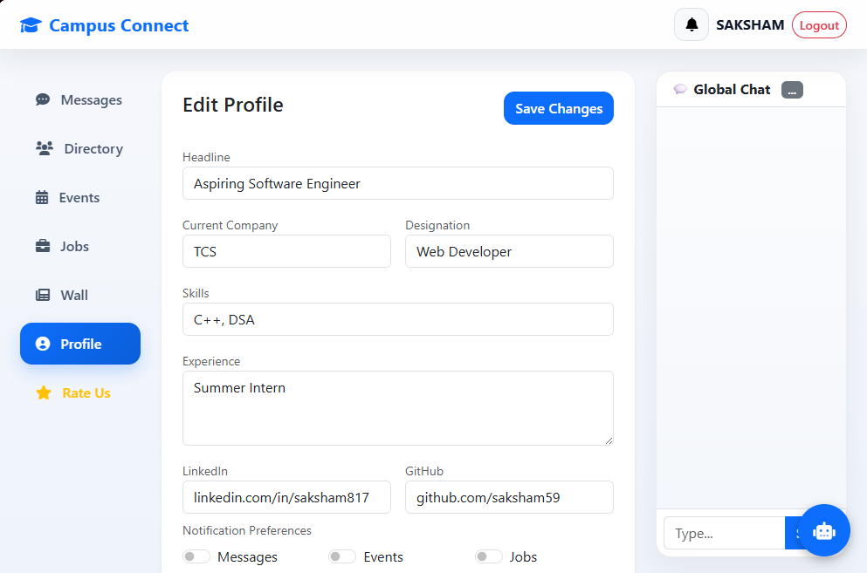
Screenshot - 3: Profile

Slide 20
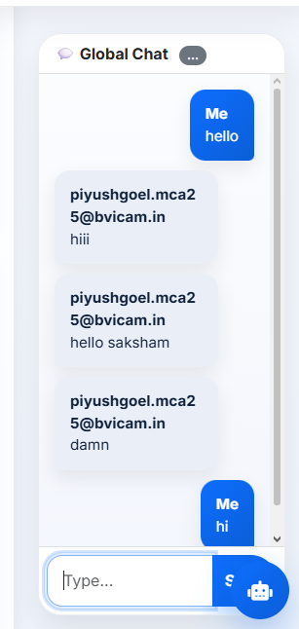
Screenshot – 4: Global Chat

Slide 21
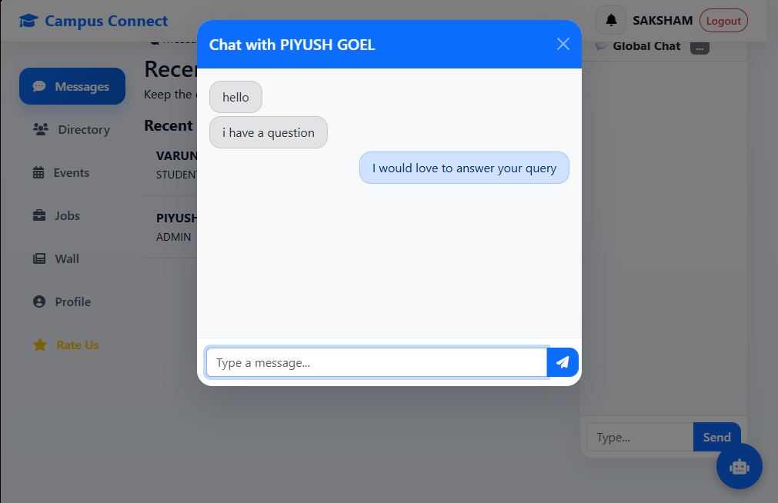
Screenshot – 5: Message

Slide 22
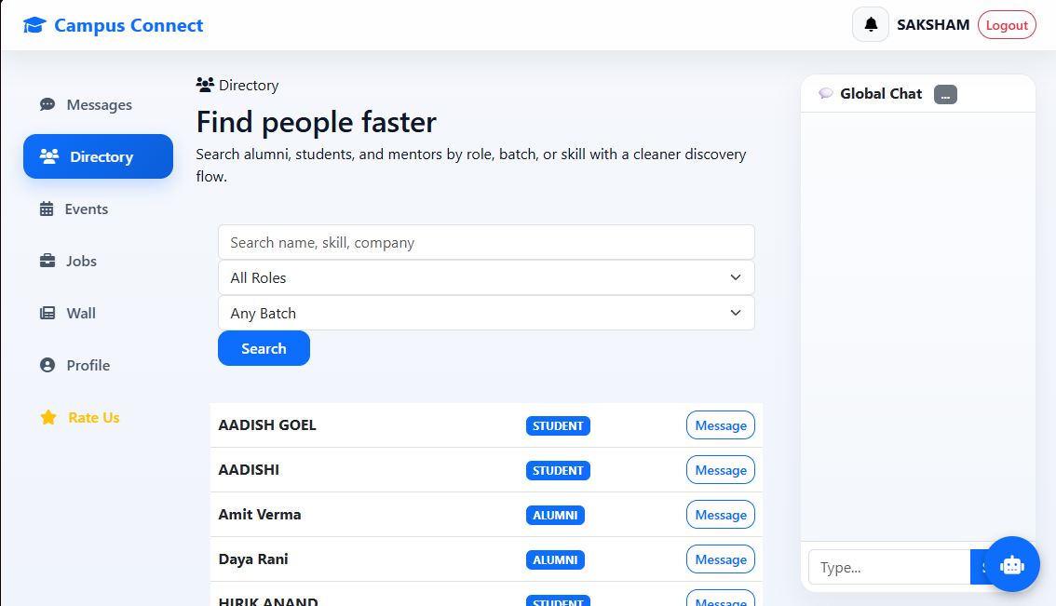
Screenshot – 6: Alumni Directory

Slide 23
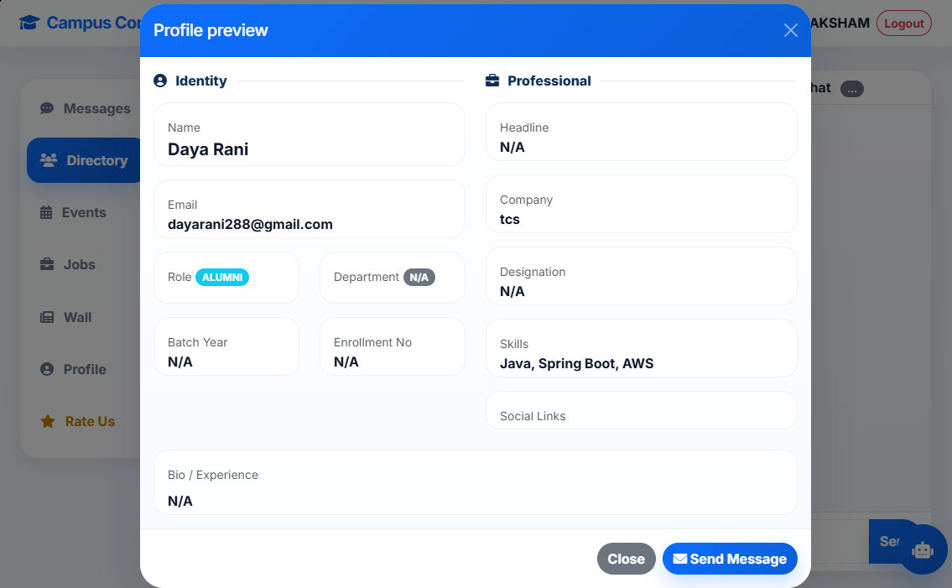
Screenshot – 7: Alumni Profile

Slide 24
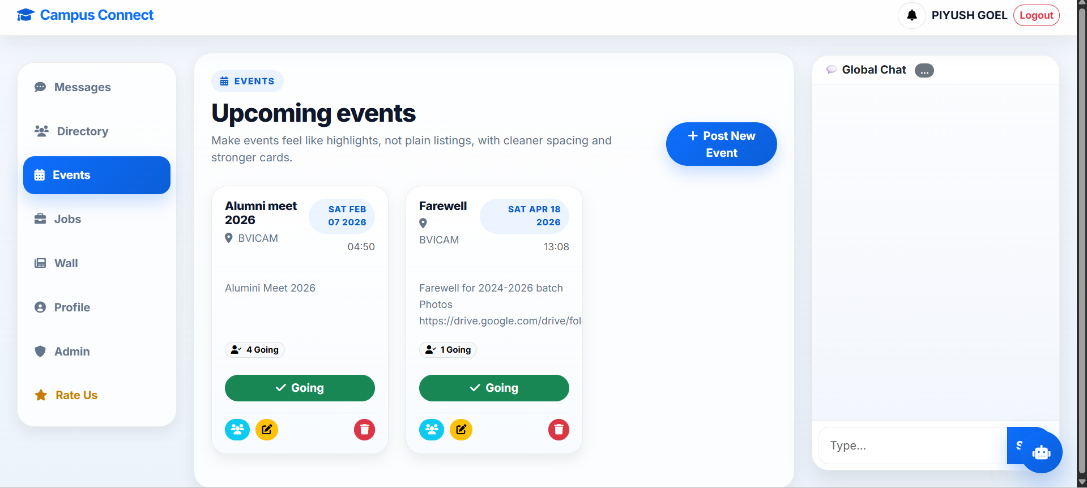
Screenshot – 8: Events

Slide 25
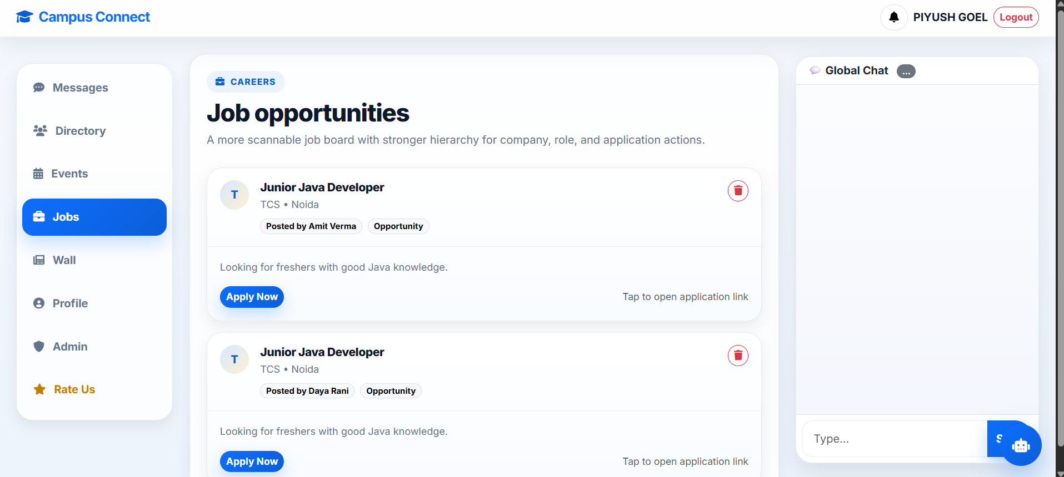
Screenshot – 9: Jobs

Slide 26
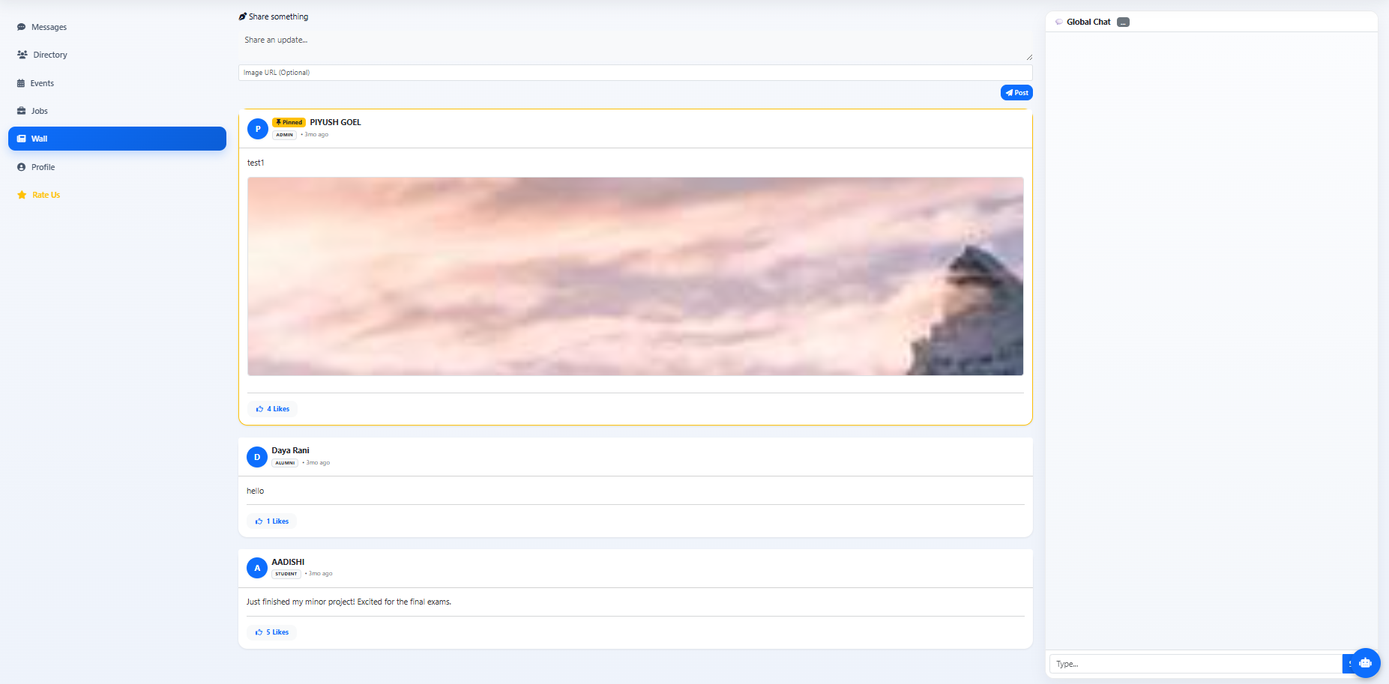
Screenshot – 10: Memory Wall

Slide 27
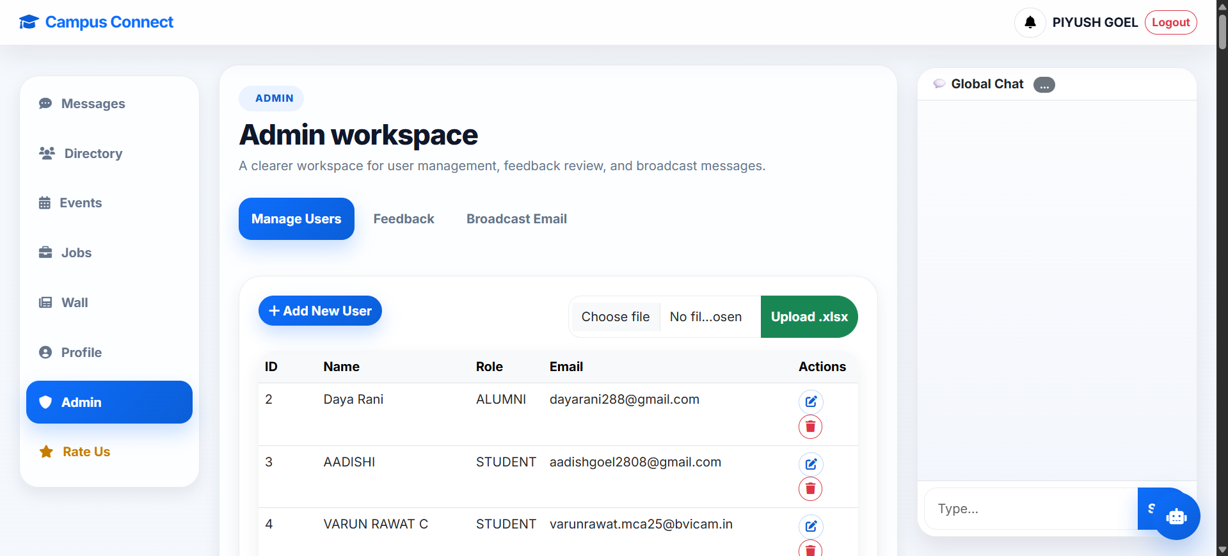
Screenshot – 11: Admin Dashboard

Slide 28
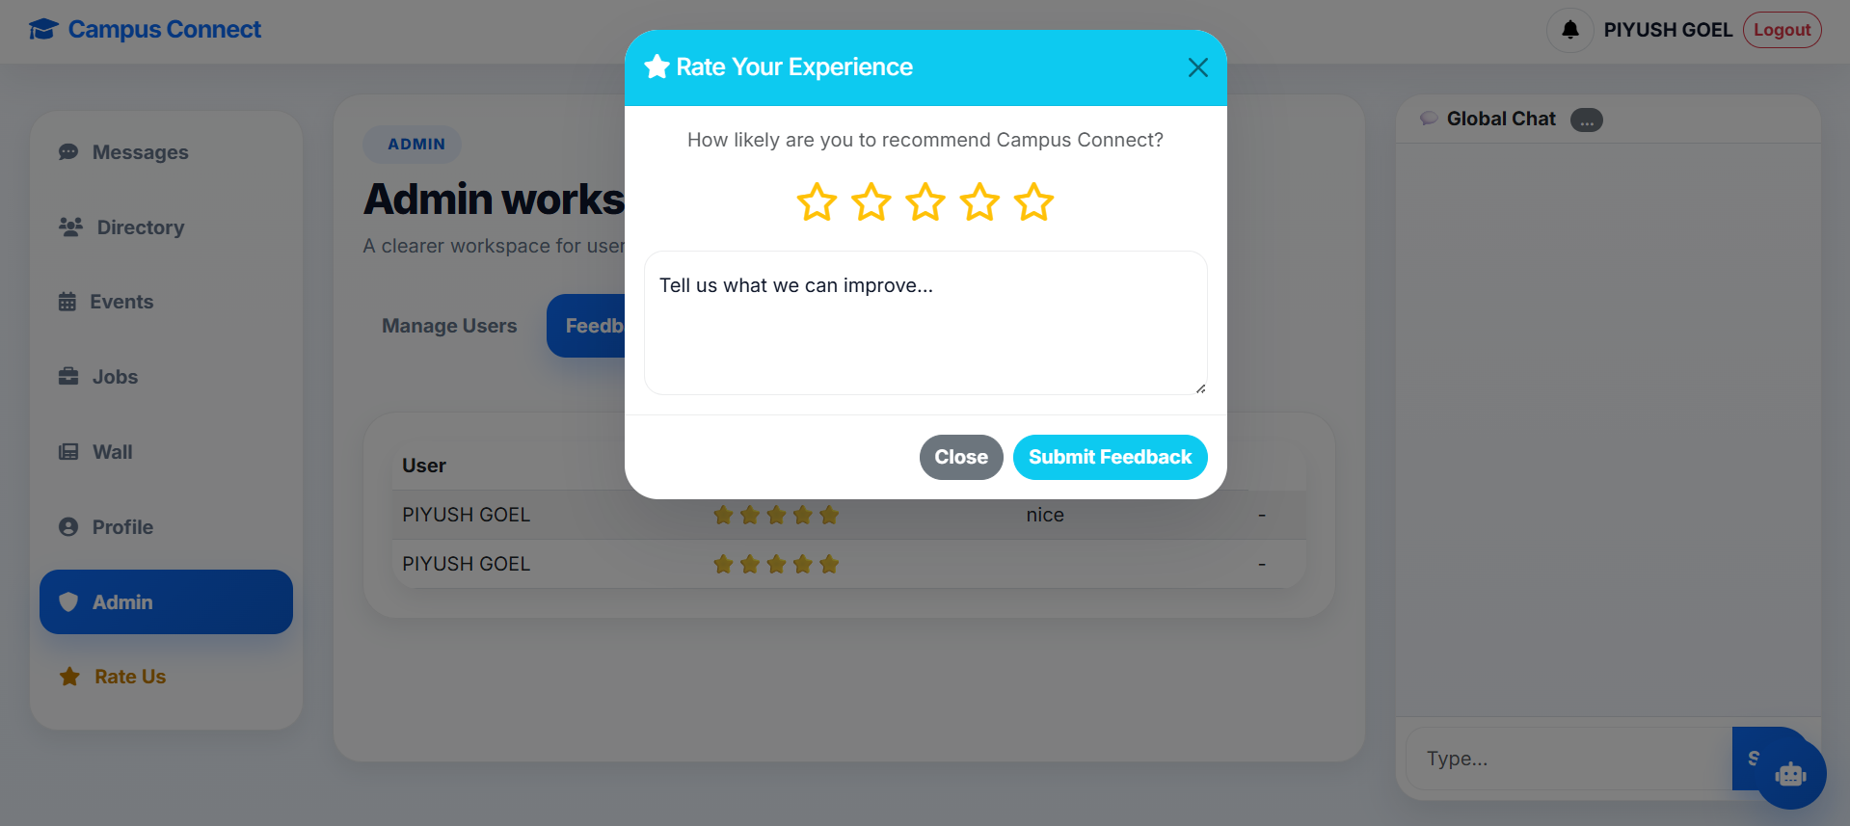
Screenshot – 12: Feedback

Slide 29
Testing of the Project
Depending upon the Nature of Project, Design and Present the Test Cases
Id | Test Case Description | Test Case Input | Test Results |  | Status | Corrective Measure
 |  |  | Expected | Actual
1 | Alumni can successfully upload there memories/pictures.. | Pictures. | Memory wall created and displayed | Pictures were uploaded and Memory wall was created | Pass | None
2 | Whether the community Message works. | Different messages by Alumni and users. | Transfer of messages | Successfully transfer of messages | Pass | None
3 | Functioning of Portal Login | Login Password | Successful Login | Successful Login | Pass | None

Slide 30
Conclusion
Campus connect, a Java based application that could bridge the gap between the current students and alumni through a user friendly digital platform.
Java Programming and JavaScript are used for System Development.
The developed application has following features:
Responsive user-friendly interfaces to interact with the system.
Easy way of updating the current Profile credentials.
A Jobs tab with information regarding exciting job opportunities.
Memory Wall.
Global chat and option for one on one Chat.
Events tab for informing the Alumni about upcoming events in college

Slide 31
Future Scope
Digital portfolio system.
Attendance tracker and Time-Table for students.
Dedicated pages for societies like IEEE where Heads can post updates, recruit members and host private chats.
A Resource Hub where students can access notes, previous year question papers and other educational resources for free.

Slide 32
Bibliography
Books:
Herbert Schildt, “Java: The complete reference”.
Eloquent JavaScript by Marijn Haverbeke
Websites:
https://bvicam.in/UploadDocuments/CourseMaterial/MCA%20109%2UNIT%20I.pdf
https://learn.oracle.com/ols/learning-path/oracle-java-foundations/88323/79726
https://docs.staruml.io/

